Slide 1
Lecture 2
Introduction to Solidity and Remix

Slide 2


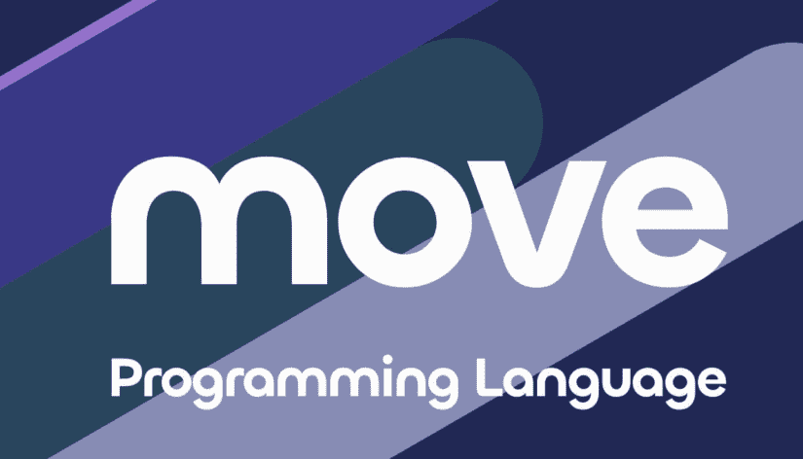
Disclaimer
1. A lot of fish in the sea
2. Documentation should be frequently referenced.

Slide 3
Computer Architecture Basics
Notes:
Value Types are directly stored in memory. Copying a value type will result in two copies in memory (deep copy)

Slide 4








Web 2 Architecture
Human readable -
"High Level"
Compilers
Translation program:
Bytecode -VM
Machine Code - Binary
ASM - Instructions
ASM
Machine Language - "Low Level"
CPU
A Turing Complete, Finite State Machine
Notes:
- opcode, data value, data value

Slide 5
Web 2 Architecture
uint a;
a = 1+1
Compilers
malloc 256;
add 1 1
write a 2
ASM
01101 256
00100 0001 0001
10001 0x456 0010
CPU
Notes:
- opcode, data value, data value

Slide 6
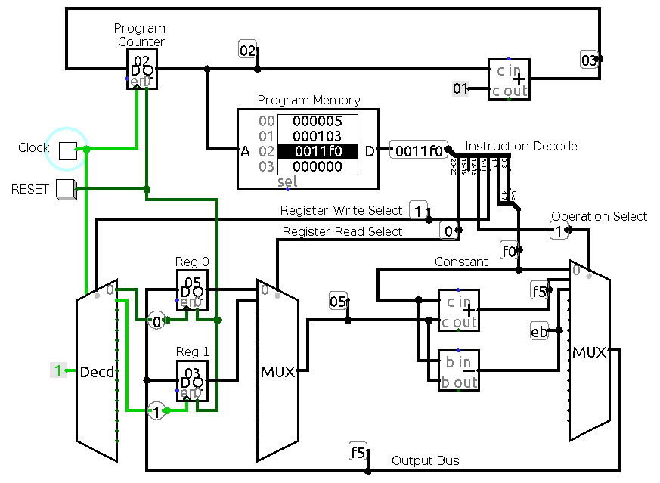
Web 2 Architecture
Decode Instructions into opcode and data
Registers to hold program essentials:
Data, loops state, pointers
Algorithmic Logic Unit
Ram read write, towards more permanent storage.
Indexed by Addresses
Notes:
Usually two registers due to instruction set decisions - bitcoin miner cpus are much more specialized
Clock is usually a few billion instructions per second

Slide 7
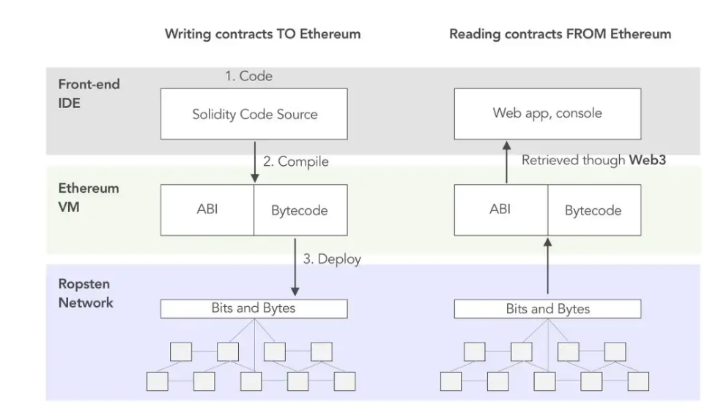
Web 3 Architecture
Remix
IDE - Code & Compiler
Full Node
RPC execution
Blockchain
Remote or Simulated
Source: https://hackernoon.com/ethernaut-lvl-0-walkthrough-abis-web3-and-how-to-abuse-them-d92a8842d71b
Notes:
- this course focuses on the top corner only
- ABI (Application Binary Interface) used to interact with the web (JS library) Bytecode for EVM execution
- In a nutshell, EVM is like compiler, Bytecode is Assembly and EVM is also the CPU minus the Persistent storage which is the blockchain

Slide 8
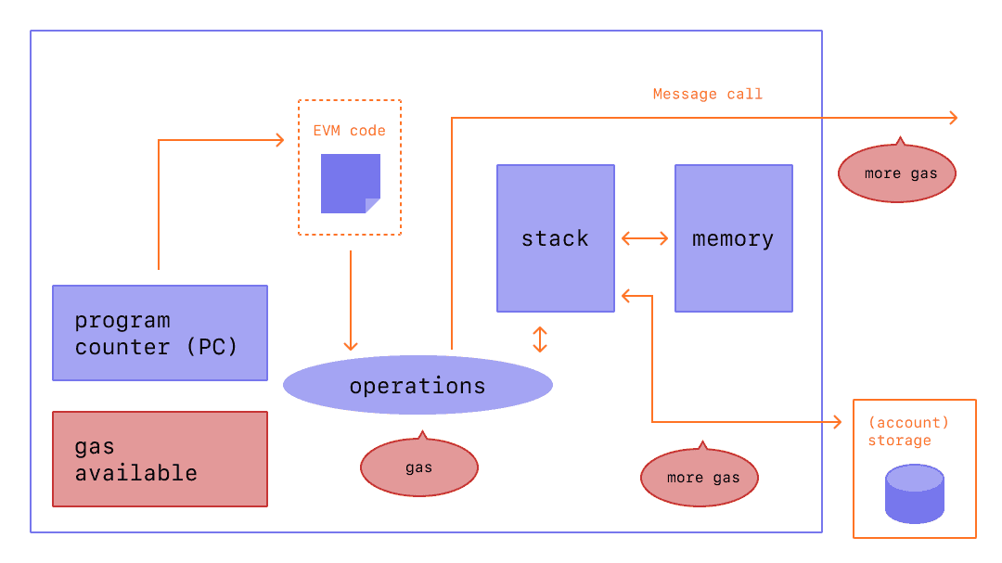
EVM - every line of code costs gas!
Notes:
- memory is temporary, renewed after every execution
- stack is even more immediate, like registers in a cpu, used when an operation needs to happen
- Account storage stores the state of the account. Gas here is incredibly expensive because it is written on the blockchain.

Slide 9
Solidity File Structure
Notes:
Value Types are directly stored in memory. Copying a value type will result in two copies in memory (deep copy)

Slide 10
Bonus Point
If a completely empty smart contract is compiled, would the resulting transaction payload, be:
A) Completely empty
B) Contain something
I
Notes:
Value Types are directly stored in memory. Copying a value type will result in two copies in memory (deep copy)

Slide 11
Inside a .sol source file
SPDX-License-Identifier
  https://spdx.dev/
  Can have an "unlicensed" identifier
pragma
  solidity version (to match compiler)
  ABI encoder / decoder
  Experimental pragmas: ABIv2, SMTchecker (Formal Verification)
Import
Comments
  Single line: //
  Multi line: /* */
  Natspec

Slide 12
npm version semantic
Solidity has not even hit 1 stable release yet!!!
^
use this specific version
>= <
range of versions to use
0
8
33
Major Release
Breaking changes
Minor Release
Features
Backwards Compatible
Patch
Bug Fix
Backwards Compatible

Slide 13
Importing
Direct Import
Virtual Filesystem on the Compiler
import "/project/lib/util.sol";
import "lib/util.sol";
import "@openzeppelin/address.sol";
import "https://example.com/token.sol";
Initial files (plus dependencies) can be loaded on CLI or JSON format.
Compiler can add other files during compile time
Relative Import
import "./";
import "../";

Slide 14
Natspec - Natural Language Specification Format
Tag |  | Context
@title | A title that should describe the contract/interface | contract, library, interface
@author | The name of the author | contract, library, interface
@notice | Explain to an end user what this does | contract, library, interface, function, public state variable, event
@dev | Explain to a developer any extra details | contract, library, interface, function, state variable, event
@param | Documents a parameter just like in Doxygen (must be followed by parameter name) | function, event
@return | Documents the return variables of a contract’s function | function, public state variable
@inheritdoc | Copies all missing tags from the base function (must be followed by the contract name) | function, public state variable
@custom:... | Custom tag, semantics is application-defined | everywhere
Notes:
Can be used to generate documentation automatically
From a web3 community manager point of view, this is important!

Slide 15
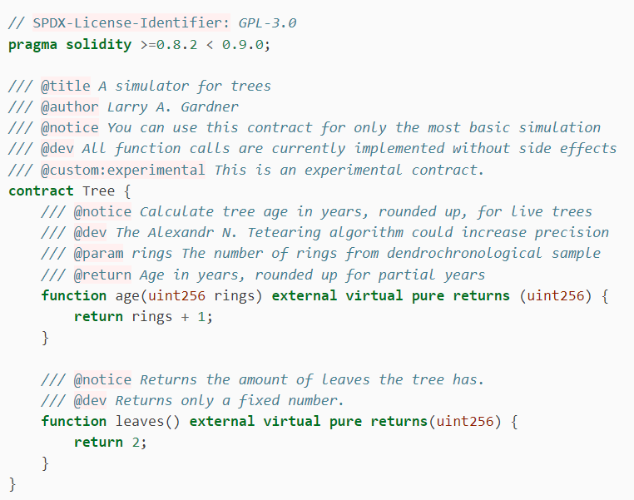
Natspec - An Example
Source:
https://docs.soliditylang.org/en/v0.8.17/natspec-format.html

Slide 16
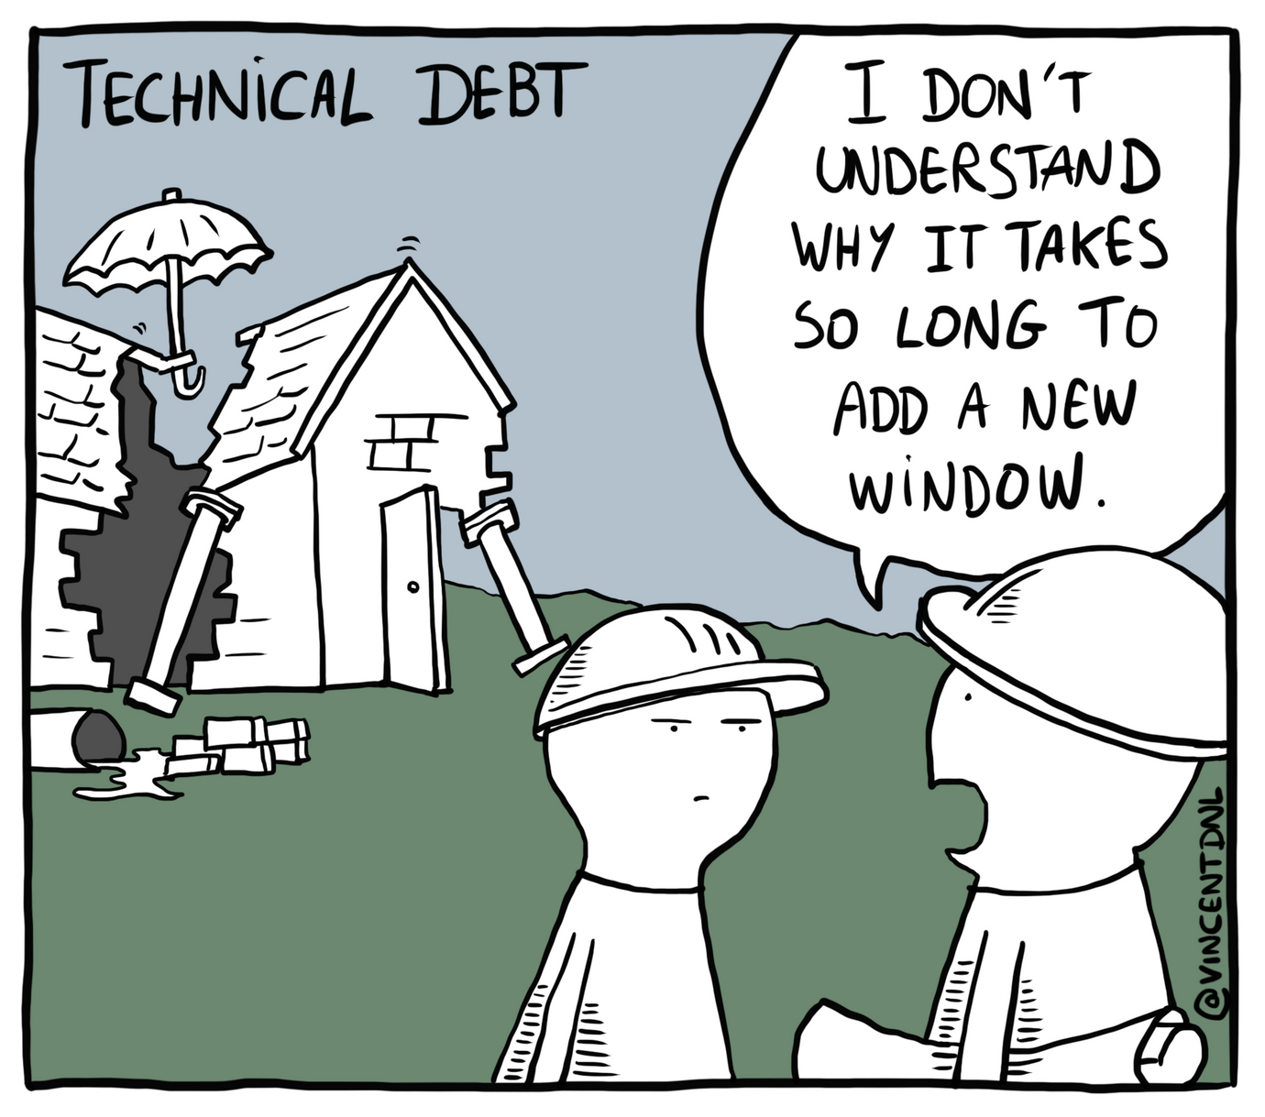
Technical debt - the cost of bad code
Notes:
Developers have the pressure to deliver on time. Sometimes this transforms into putting an umbrella to cover unfinished roofs and using a pole to prop up an unfinished wall. In the end, adding anything new, even something as simple as a window, takes a very long time
Time can then be calculated as developer salaries. In this way, companies waste a lot of money!! Managing deadlines vs technical debt is an incredibly important business decision.

Slide 17
Solidity Conventions
Max Line Length = 120 char Breakdown new lines uses tabs | thisFunctionCallIsReallyLong( longArgument1, longArgument2, longArgument3 );
Encoding | UTF-8 or ASCII
Import Statements Always at top after license identifier and pragma | // SPDX-License-Identifier: MIT pragma solidity >=0.4.0 <0.9.0; import "./Owned.sol";
Whitespace No space between brackets/quotes Space around operators | spam(ham[1], Coin({name: "ham"})); x = 1; y = 2;

Slide 18
Solidity Conventions - Naming
Contracts, Libraries, Interfaces, Structs, Events | CapWords contract MyContract{} struct PersonStruct{}
Function Names, Function Arguments, Variable Names | mixedCase int myInteger; function helloWorld();
Constants | ALLCAPS int WINNING_NUMBER = 5;

Slide 19
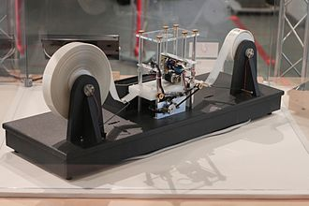
How turing complete programming languages are built
Read/Write values. What are they?
Integer, String, Maps, etc.
How are these values stored in the cell?
Static vs dynamic
Left or Right?
Control flow - for and while

Slide 20
Primitives
Value Types
Notes:
Value Types are directly stored in memory. Copying a value type will result in two copies in memory (deep copy)

Slide 21
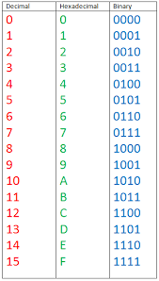
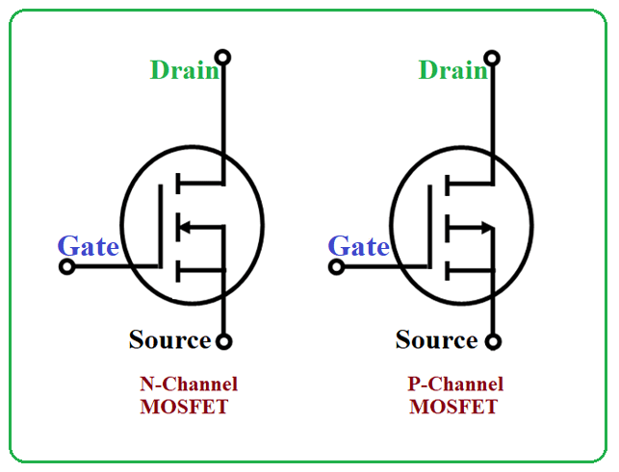
Primitives - binary
At the most basic level, computers operate on 1 and 0 - This system is called Binary.
From a hardware perspective:
High voltage (5V) = "1"
Low voltage (0V) = "0". Currently, these are the only 2 possible states and why computers are binary in nature.
Quantum computing aims to break this constraint!

Slide 22
Primitives - binary
Let's take a look at the Decimal System
7
3
1
0
1
1
In a single column, we keep going until the maximum has been reached
Thousands
Hundreds
2
. . .
Once the maximum number in a lower column has been reached, we advance to the next column on the left.
All previous columns start from 0.
8
9

Slide 23
Primitives - binary
Same intuition for a Binary System
0
0
0
0
1
1
1
1
Notes:
Likewise in Hexadecimal, you have additionally A - F! 16 = 10

Slide 24
Binary to Decimal converter
1
1
0
1
2³ + 2² + 2¹ + 2⁰
= 8 + 4 + 1
= 13
Notes:
Likewise in Hexadecimal, you have additionally A - F! 16 = 10

Slide 25
Primitives - integers
uint8
uint16
uint32
uint64
uint128
uint256
int8
int16
int32
int64
int128
int256
No floating points? No Problem!
ETH -> GWEI -> WEI
Notes:
In solidity, we have all these possible types to represent numbers. Mostly dont matter and if you just write int then 256 is assumed. But memory matters.
u means unsigned

Slide 26
Primitives - integers
The first bit becomes the "sign" -> 0 is a positive number, 1 is negative.
0
1
0
1
1
0
Since 1 bit is taken up to mean the sign, remember you can only have numbers half as big as unsigned integers

Slide 27
Primitives - integers
bits and Bytes
Each storage unit is a bit.
There are 4 bits here
8 bits = 1 Byte
1
0
1
0
Note: KB -> MB -> GB -> TB -> PB is not 10³ = 1000 but 2¹⁰ = 1024 intervals!
Notes:
How to go from decimal to binary? homework!

Slide 28
Primitives - Bytes
8 bits = 1 Byte
bytes1
bytes2
bytes3
…
bytes31
bytes32
Every "cell" in EVM memory is 256 bits (32 Bytes)
Notes:
This is a value type because size is predetermined

Slide 29
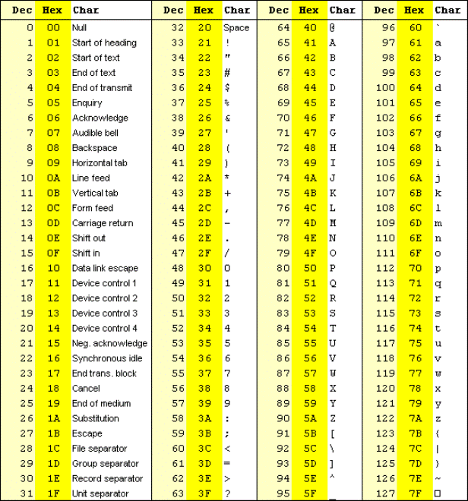
UTF8 Encoding
This is unicode. The OG encoding.
As encoding formats expanded to include more scripts and even emojis, there was:
UTF8 → UTF16 → UTF32…
ASCII and more

Slide 30
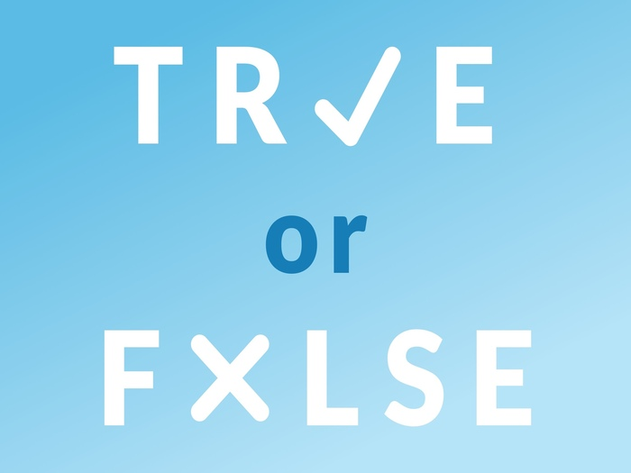
Primitives - Boolean
Notes:
always write true or false. Some languages can support 1 and 0 but Solidity too young

Slide 31
Primitives - Addresses
0xFd348ab656a6127f4280C5b1218D46D80a41e224
20 Bytes = 160 bits

Slide 32
Operators
Algorithmic | Relational | Logical
+ - / * | == | &&
++ - - | < > <= >= | ||
% | != | !
Notes:
keccak exception

Slide 33
Arrays, Mapping, String, Struct
Reference Types
Notes:
Reference Types stores an address to where the actual type is stored!! When a changes, b will also change in value

Slide 34
Type - Array
int
int
int
bool
bool
bool
5
67
23
array[0] = 5
array[1] = 67
array[2] = 23
indexes start at 0!
0
1
2
array.push | array.length
array.pop | delete array

Slide 35
Type - String
H
E
L
L
O
!

Slide 36
Type Casting
Solidity Strings have no functions!!!
string hello = "hello";
bytes casted_hello = bytes(hello);
uint8 a = 1; => 00000001
b = uint16(a); => 0000000000000001
Bonus: Is it dangerous to go the other way around? Eg. uint 16 => uint8
Notes:
Can't go from bytes to string
can' go from int to bytes

Slide 37
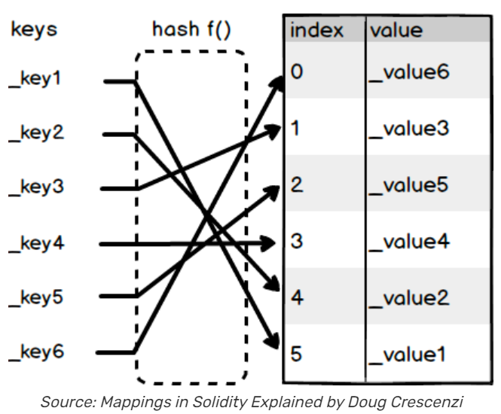

Type - Mapping
Key
=>
value
Now it's getting annoying…
- can't find length
- can't loop through keys
Notes:
Can be any type - even complex types!

Slide 38


Type - Struct
struct Object {
property1;
property2;
}
Nesting allowed!
Observe tight variable packing
Object.property
https://fravoll.github.io/solidity-patterns/tight_variable_packing.html
Notes:
used to group different Types together
nesting allowed have a struct in a struct (or a mapping where the key maps to a mapping)
keep similar types together to save memory - memory fragmentation - tight variable packing

Slide 39
Memory Fragmentation
struct a{
uint128 Hello;
uint256 World;
uint128 Today;
}
struct a{
uint128 Hello;
uint128 Today;
uint256 World;
}
Today
World
World
Hello
Today
Hello

Slide 40
Solidity Variables
Instantiation and Scope

Slide 41
Existence is….. dynamic and fixed / variable and literal
Dynamic
Can only do if in storage, expensive and painful
int[] fixed;
Fixed
Amount of memory needed known upon declaration
int[5] fixed;
int[] fixed = new int(5);
variable
Only the type is known
int a;
literal
type and value known
int a = 5;

Slide 42

Scope
Private
Getter Function
Public
Internal? External?

Slide 43
Instantiation
Type
Scope
Name
mapping(address =>string[]) internal ownerToList
struct Person{
string Name;
uint8 age;
}
uint[7] public numbers_fixed;
bool private b;
uint[] public numbers;
uint public a;
Person memory a =

Slide 44
Flow Control
if, for, while

Slide 45
If ….else
if (condition){
execution when condition is true
} else {
execution for all cases when condition is false
}

Slide 46
for loop
for (initialize counter; condition of counter; increment counter) {
continue executing until condition is met;
}
for (uint i = 0; i < 10; i++){
start i from 0, do thing until i is 9 and i increases by 1 each loop;
}

Slide 47
while loop
while (condition) {
continue execution until condition becomes false
}
Break - get out of loop now!
Continue - skip the reminder of the execution, go to next iteration
Notes:
loop control

Slide 48
Decimal to Binary Converter
Remix full workflow

Slide 49
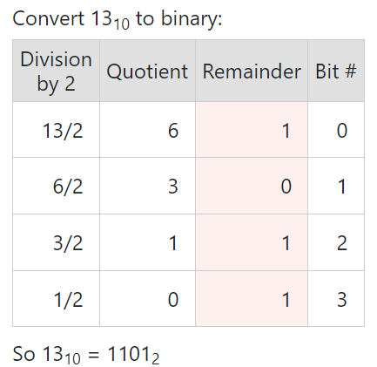
Visualise how you will solve the problem
1. Loop through decimal number
2. Get its Quotient & Reminder
3. Store Remainder
4. Flip Remainder array and turn into string
5. Return result

